Slide 1
the History of Containers
By : Oren Oichman
Title: Senior Solution Architect
Email : ooichman@redhat.com
IRC : two_oes/ooichman

Slide 2
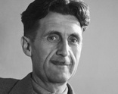

“Who controls the past controls the future. Who controls the present controls the past.”
The History of Containers
George Orwell,
1984
Source:
Insert source data here
Insert source data here
Insert source data here

Slide 3
The Evolution of Platforms
The History of Containers
From Physical to Container
Linux Was Born
Kubernetes
Linux is a family of open-source Unix-like operating systems based on the Linux kernel,^{[10]} an operating system kernel first released on September 17, 1991
VMware
Kubernetes (commonly stylized as k8s^{[4]}) is an open-source container-orchestration system for automating computer application deployment, scaling, and management
Physical Server
filed for a patent on their techniques, which is granted as U.S. Patent
The term “server” was burn in the computer world .
1970
1993
2011
1969
1991
1998
2014
CS Count
Red Hat
Docker
The start of any counter application for Delta measures begins at 01/01/1970
An open source software products to enterprises. Founded in 1993
Docker Inc. was founded by Solomon Hykes and Sebastien Pahl during the Y Combinator Summer 2010 startup incubator group and launched in 2011

Slide 4
From Physical to Containers
The History of Containers
Optional subheading
Each Physical Server had features by the Manufacturer vendor and OS had to adopt to new hardware technologies
Virtualization possibilities :
Running more than 1 OS on a Physical Server
Hardware Manufacture became Commodity
Containerize possibilities :
Completely different update process for the application and the OS

Slide 5
The Evolution of application
The History of Containers
The core for application development shift
Physical
Virtual
Containerized

Slide 6
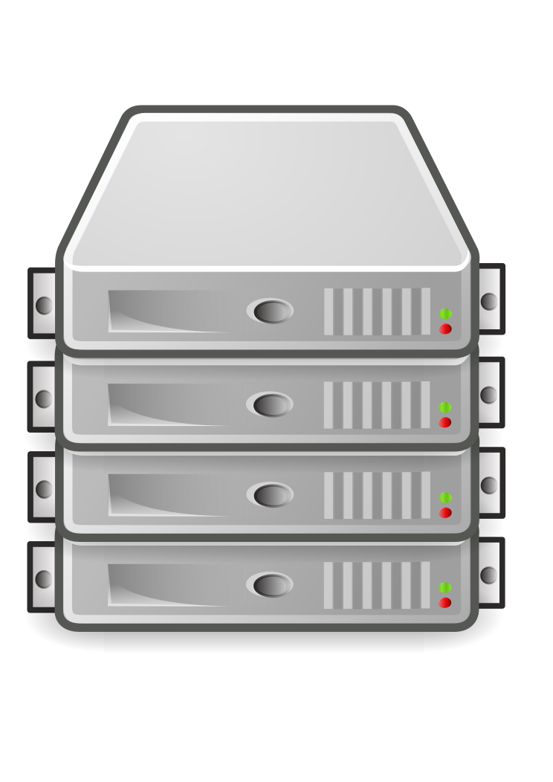
Development (P.O.V) on a physical Server
The History of Containers
Long time to produce Very long time from design to production
Taking turns With only a few available developers had to “wait in line”
Sync with the OS The Operating System had to have the latest drivers and firmware
Conflicting libraries Libraries that new application needed where not included due to Operating System conflict
Source:
Insert source data here
Insert source data here
Insert source data here

Slide 7
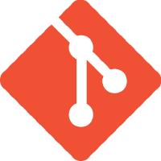
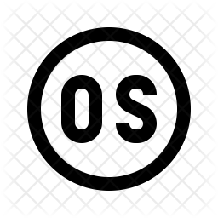

Development Timeline
The History of Containers
Phase I
Phase II
Phase III
Phase IV
Phase V
Plan
Build
Release
deploy
Monitor
Planning on how the application should look like
Build the application with the selected Code
App lifecycle, storage
Metrics, alerts, log
Horizontal/vertical scaling,
lifecycle (backup, failure
processing and workload
auto conﬁg tuning, abnormal
recovery)
analysis
detection, scheduling tuning
Version 1
Version 2
Version 3

Slide 8
Virtualization concept
The History of Containers
In computing, virtualization (alternatively spelled virtualisation) refers to the act of creating a virtual (rather than actual) version of something, including virtual computer hardware platforms, storage devices, and computer network resources.
Virtualization began in the 1960s, as a method of logically dividing the system resources provided by mainframe computers between different applications. Since then, the meaning of the term has broadened
Source:
Insert source data here
Insert source data here
Insert source data here

Slide 9
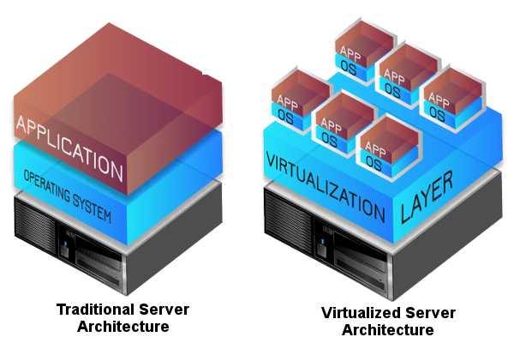
Developing on a Virtual Server (benefits)
The History of Containers
More than 1 OS on a physical Server.
The Hardware drivers are commodity and so not relevant to the development process
Source:
Insert source data here
Insert source data here
Insert source data here

Slide 10
Development Timeline
The History of Containers
Phase I
Phase II
Phase III
Phase IV
Phase V
Plan
Build
Release
deploy
Monitor
Planning on how the application should look like
Build the application with the selected Code
App lifecycle, storage
Metrics, alerts, log
Horizontal/vertical scaling,
lifecycle (backup, failure
processing and workload
auto conﬁg tuning, abnormal
recovery)
analysis
detection, scheduling tuning
Version 1
Version 2
Version 3
Version 1
Version 2

Slide 11
Container concept
The History of Containers
A container is a class, a data structure or an abstract data type (ADT) whose instances are collections of other objects.
In other words, they store objects in an organized way that follows specific access rules.
The size of the container depends on the number of objects (elements) it contains.
Underlying (inherited) implementations of various container types may vary in size and complexity, and provide flexibility in choosing the right implementation for any given scenario.
Source:
Insert source data here
Insert source data here
Insert source data here

Slide 12
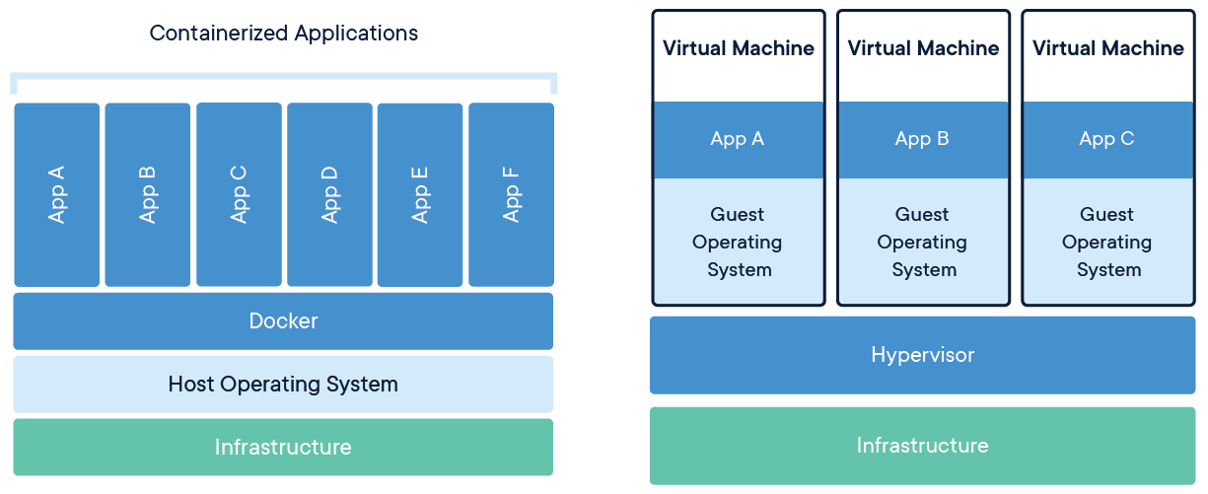
Developing on a Container (benefits)
The History of Containers
Each app as their own sandbox and set of libraries and binaries
Minimal dependency in the Operating system
Dedicated life cycle
Container implementation
Source:
Insert source data here
Insert source data here
Insert source data here

Slide 13
Development Timeline
The History of Containers
Phase I
Phase II
Phase III
Phase IV
Phase V
Plan
Build
Release
deploy
Monitor
Planning on how the application should look like
Build the application with the selected Code
App lifecycle, storage
Metrics, alerts, log
Horizontal/vertical scaling,
lifecycle (backup, failure
processing and workload
auto conﬁg tuning, abnormal
recovery)
analysis
detection, scheduling tuning
Version 1
Version 2
Version 3
Version 4
Version 5
Version 6
Version 1
Version 2
Version 3
Version 1
Version 2

Slide 14
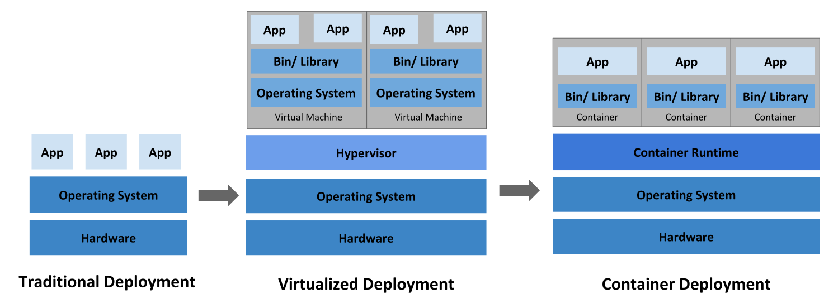
The Evolution of Containers

Slide 15

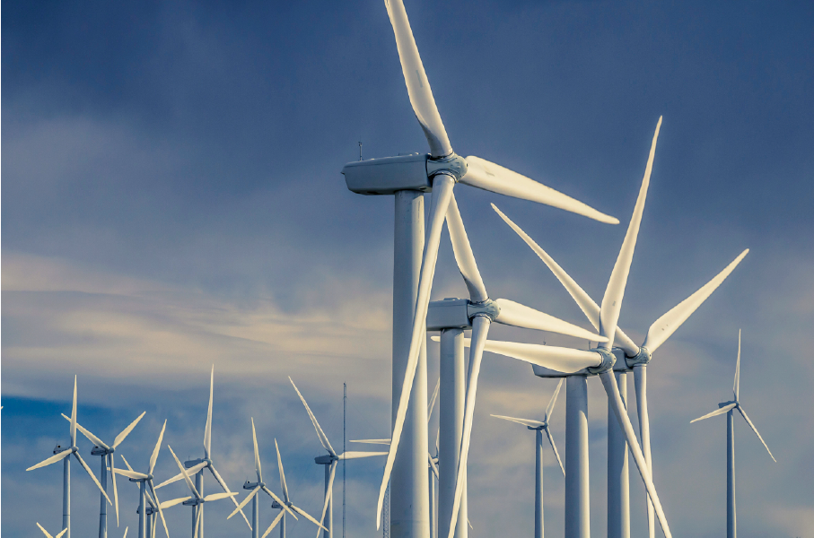
The History of Containers
Begin Exercise 1
Source:
Insert source data here
Insert source data here
Insert source data here

